Slide 1
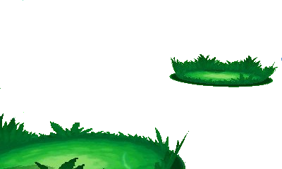
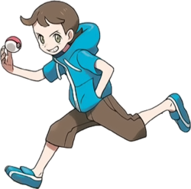
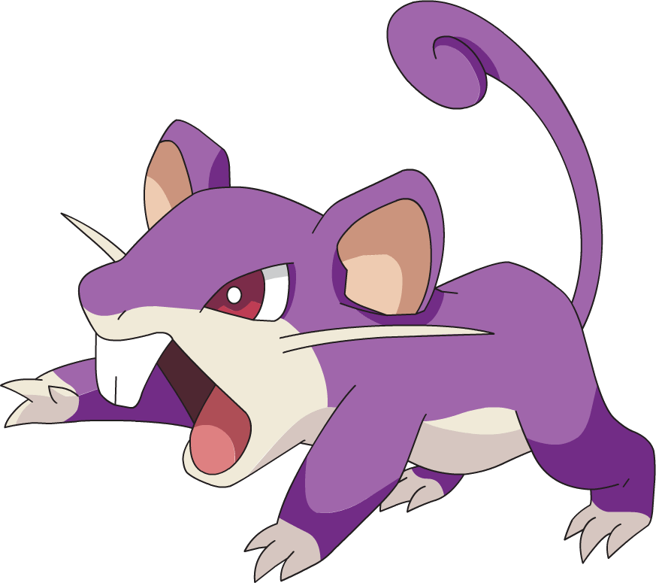

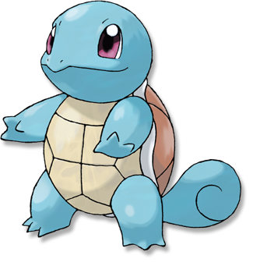
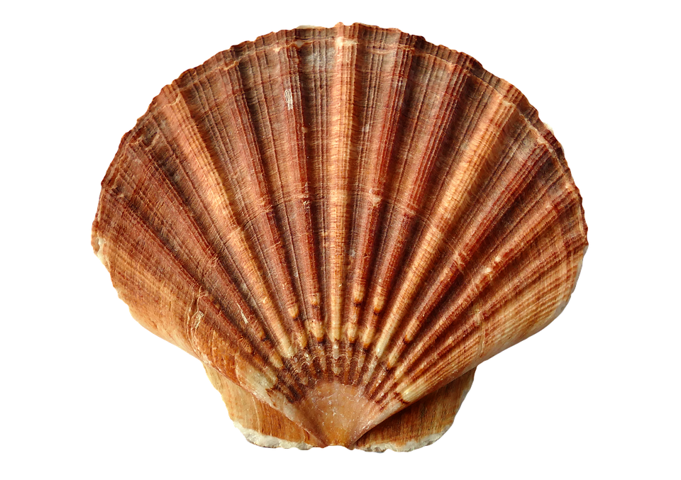


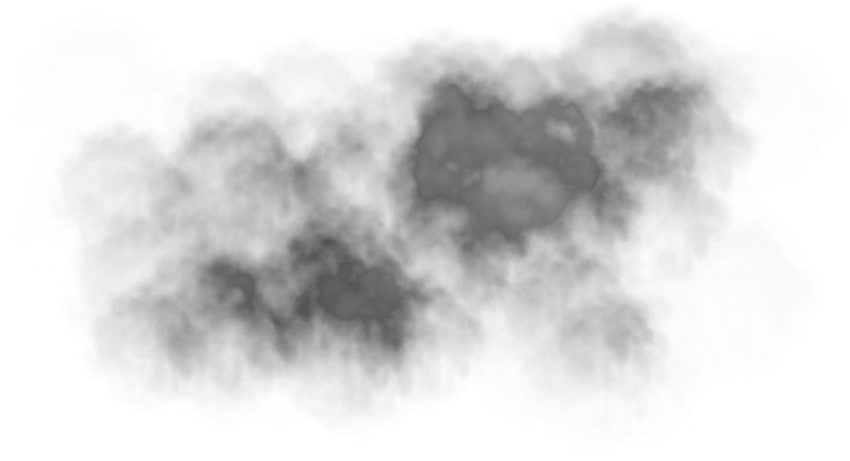

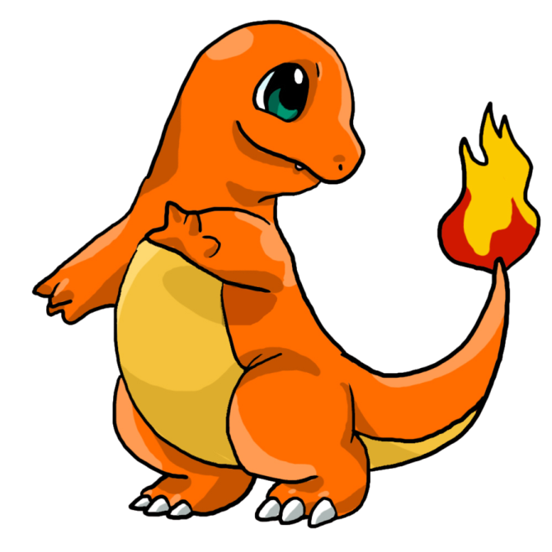
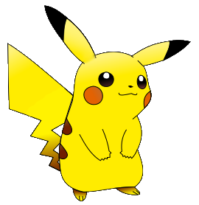
K.O.
Use tackle
Use wirthdraw
Use Quick attack
Use Bubble
Go Rattata
Go Squirtle
I will win next time
Use thundershock
Use thunder
Use Ember
Go Pikachu
Go charmander
Use Smokescreen
Use Scratch
You are challenged by youngster Joey

